Slide 1
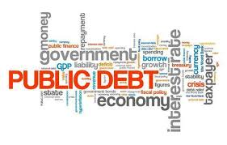

The U.S. Federal Debt
OLLI – University of Hawai’i
July 30, 2026
Robert Rebelein, Ph.D.
Associate Professor of Economics
Vassar College, Poughkeepsie, NY

Slide 2
Course Schedule
Contemporary Economic Policy
  Week 1 (7/2): Saving Social Security, Geoffrey Woglom, Amherst College
  Week 2 (7/9): Trade & Globalization, Luisa R. Blanco, Pepperdine University
  Week 3 (7/16): Crypto Currencies and the Future of Money, Geoffrey Woglom
  Week 4 (7/23): Economics of Immigration, Luisa R. Blanco, Pepperdine University
  Week 5 (7/30): Federal Debt and Deficits, Robert Rebelein, Vassar College
  Week 6 (8/6): Climate Change Economics, Gary Yohe, Wesleyan University

Slide 3
Submitting Questions
Please submit questions in the chat
  I will try to handle them as they come up but may take them in a bunch as time permits.
We will have a verbal Q&A after the presentation
Slides will be available from the NEED website tomorrow (https://needelegation.org/delivered_presentations.php)

Slide 4
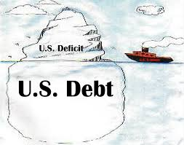
Deficit (or Surplus) vs. Debt
Deficit (or Surplus) are Annual amounts (Flows)
  Deficit: The excess of outlays over revenues within a year.
  Surplus: The excess of revenues over outlays within a year.
Debt is the accumulation of ALL past deficits
and surpluses (Stock)

Slide 5
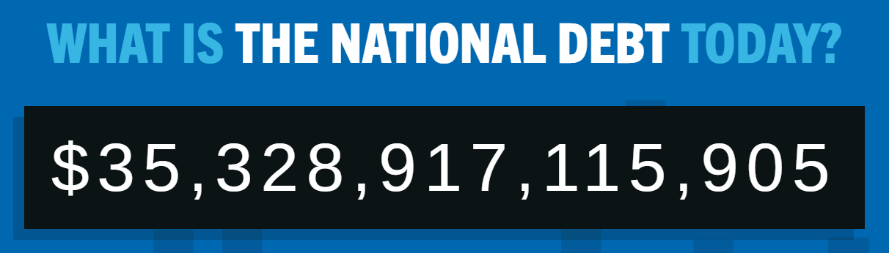
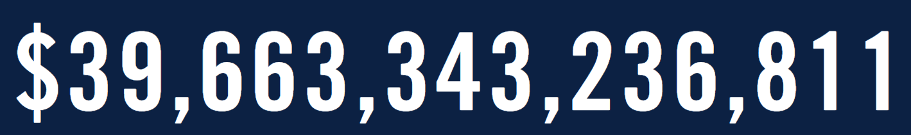
Grows at about $89,000/second; over $7 billion every day
Notes:
https://www.pgpf.org/national-debt-clock

Slide 6
The Relative Debt
Economists analyze the debt relative to GDP because:
  To the extent that debt and deficits have burdens, these burdens depend on the size of the debt relative to the size of the economy.
 | Total Public Debt | Relative Debt: Debt/GDP
United States | $40 Trillion | 125%
Greece

Slide 7
The Relative Debt
Economists analyze the debt relative to GDP because:
  To the extent that debt and deficits have burdens, these burdens depend on the size of the debt relative to the size of the economy.
 | Total Public Debt | Relative Debt: Debt/GDP
United States | $40 Trillion | 125%
Greece | $0.215 Trillion | 170%

Slide 8
How Did we get here?
U.S. government has (almost) always had some debt
Notes:
Except for 1835-1837

Slide 9
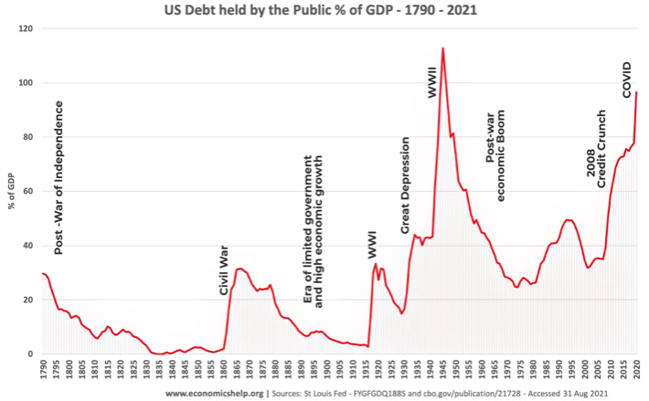
History of U.S. Debt/GDP

Slide 10
Why Has the Federal Debt Risen So Much?
Simple math tells us: spending exceeds revenues
More specifically:
Demographics – about 60 million Americans age 65+
Health care – spend twice as much per capita as other OECD countries
Tax cuts
Notes:
Were only 40 million age 65+ in 2010 and projected to have 80 million age 65+ in 20 years

Slide 11
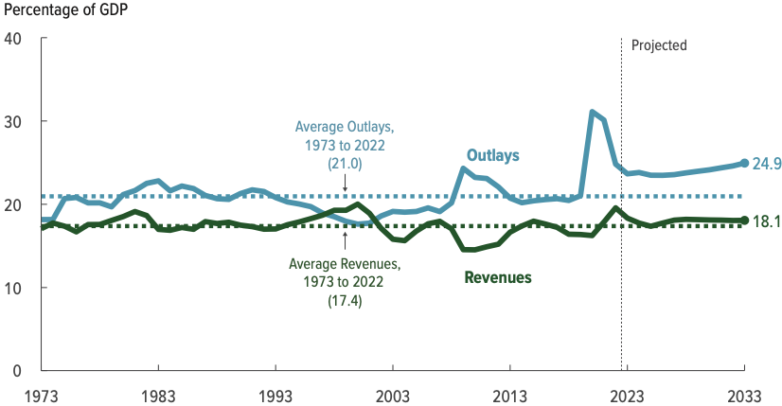
Why Has the Federal Debt Risen So Much?

Slide 12
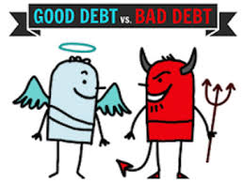
Not All Borrowing Is Bad!
Two good reasons to borrow:
  During a temporary crisis
    e.g., Recession/ War/ Pandemic
  Productive public investment
    e.g., Infrastructure/ Education
These deficits did not permanently increase relative debt:
  Great Depression, WWII
  Public investment expands GDP and tax revenue

Slide 13
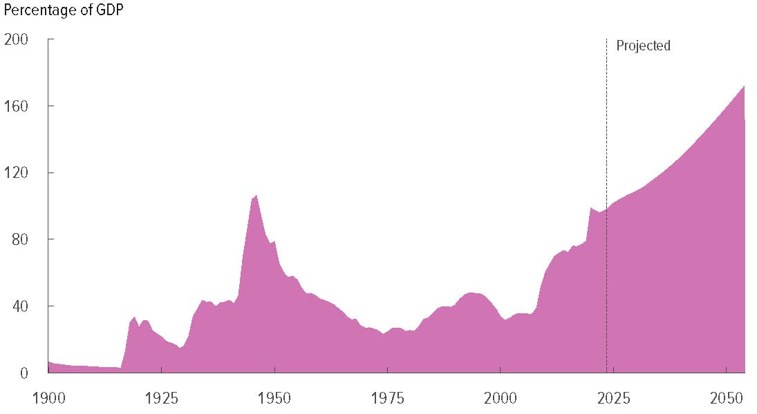
Path of U.S. Debt (% of GDP)
172% of GDP
by 2054
Covid
WWII
Financial
Crisis
Reagan
Tax cuts
WWI
Notes:
Chart from CBO

Slide 14
Key Points About US Relative Debt
Prior to 1983, relative debt rose (wars and recessions) and then fell.
Relative debt peaked during World War II, then declined for several decades. (even though total debt continued to grow!)
Relative debt has been and is expected to rise for the foreseeable future w/o a strategic purpose.

Slide 15
Debt Dynamics
Relative debt is a fraction: Debt/GDP; this fraction falls if:
  The numerator falls (budget surplus)
  The denominator rises (nominal GDP growth)
  The denominator grows faster than the numerator

Slide 16
Measuring the Debt
Not all debt is borrowed from the public
Treasury Department also borrows from many different U.S. government agencies
  Called “intragovernmental borrowing”
  about 20% of the total
This gives us two different measures of the Debt:
  Total Federal Debt
  Debt Held by the Public

Slide 17
Measuring the Debt
Total Federal Debt is about $40 Trillion
Minus Intragovernmental Debt of about $8 Trillion
Leaving “Debt Held by the Public” of about $32 Trillion
  Most studies of debt focus on just this part

Slide 18
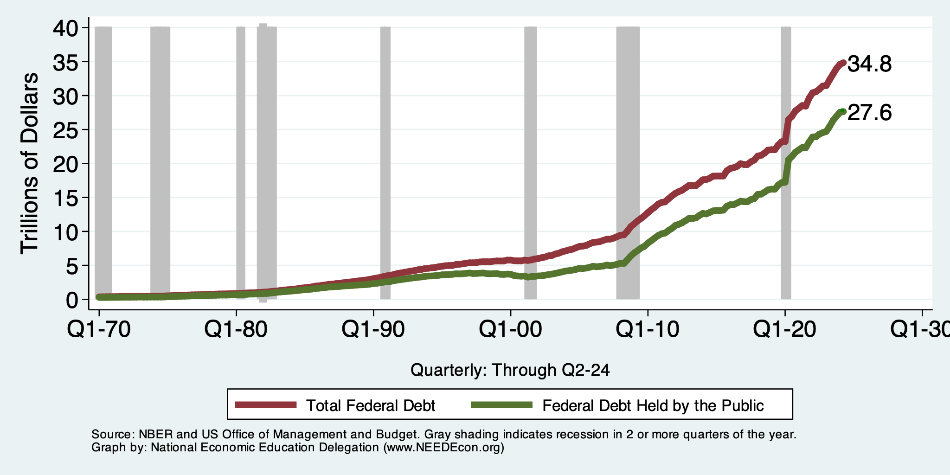
Two Measures: Total Debt vs. Debt Held by Public

Slide 19
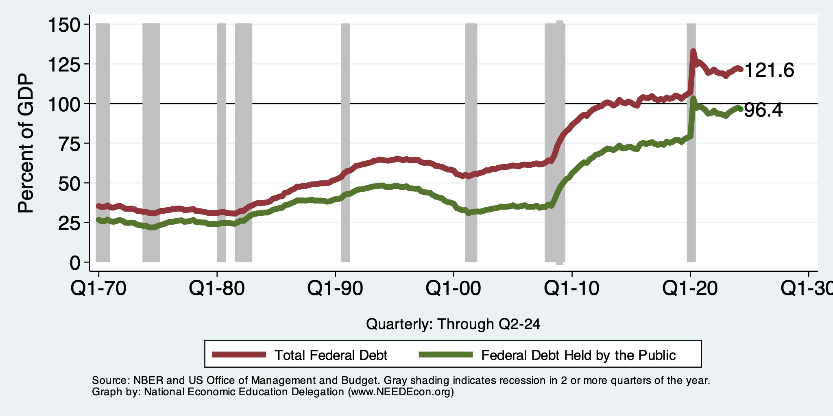
Two Measures of RELATIVE Debt

Slide 20
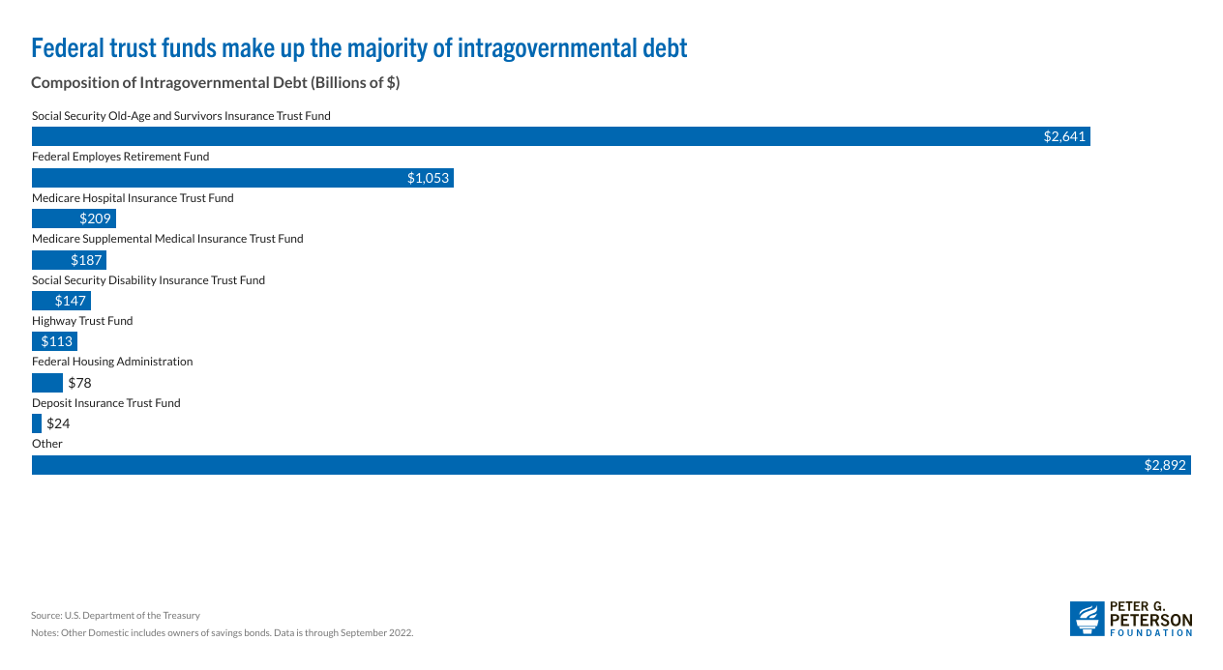
Sources for intragovernmental debt?

Slide 21
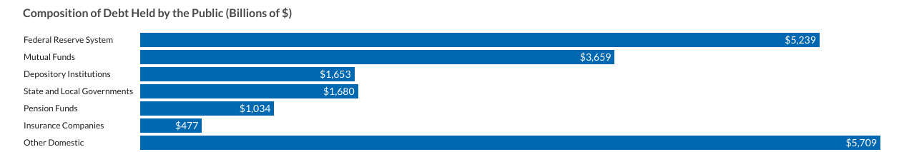
Who owns the debt held by the public?
Domestic debt-holders:

Slide 22
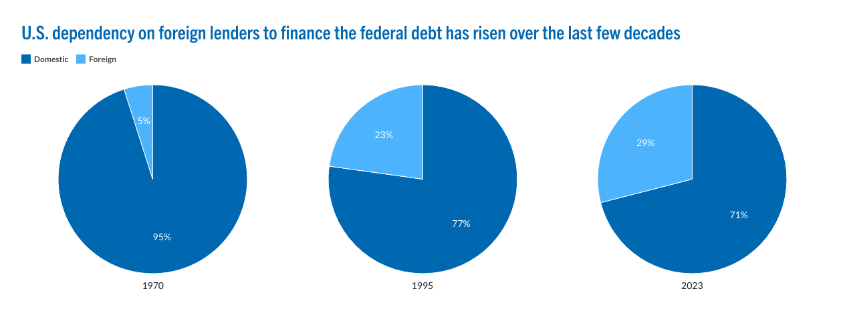
Who owns the debt held by the public?
Foreign Owned: $14 billion $7.9 trillion
Notes:
Graphics from “The Federal Government has borrowed trillions, but who owns all that debt?” published by the Peter G. Peterson Foundation, 8/6/2024

Slide 23
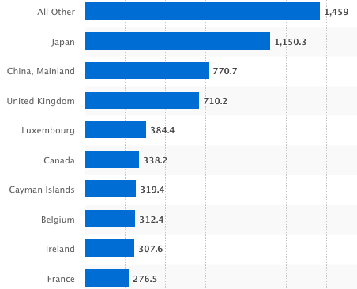
Who owns the debt held by the public?
Foreign debt-holders:
Billions of U.S. Dollars
April 2024
Source: https://www.statista.com/statistics/246420/major-foreign-holders-of-us-treasury-debt/
Notes:
Foreign holdings peaked at about 48.% of debt held by the public in 2012 and have steadily declined since then

Slide 24
Why Do Foreign Investors Buy US Treasuries?
The US economy has a history of political and economic stability and of always repaying its debts.
The dollar is the largest international reserve currency (59%)
  Most trade transactions (e.g., oil) are quoted in dollars (54%)
  Foreign governments, companies, and citizens borrow in dollars (64%)
  90% of currency exchange transactions involve the dollar on one side or the other
Market for U.S. Treasury securities is the deepest, most liquid capital market in the world.
Notes:
Dollar assets comprise about 59% of global foreign currency reserves; the next largest share is the euro at 20%. Borrowing. Foreign governments and corporations borrow money in dollars to insure their creditors against foreign exchange risk; 64% of world debt is denominated in dollars. From The changing role of the US dollar by Sam Boocker and David Wessel, August 23, 2024, The Brookings Institution

Slide 25
Three Major Questions:
What economic effects do deficits have?
Why is it so hard to reduce the deficit?
What could happen if our debt continues to increase?

Slide 26
Not All Debt Is Created Equal
Intragovernmental debt is (important) bookkeeping, but this debt does not affect capital markets.
Debt held by the public can reduce the availability of investment funds to other borrowers.
  Often referred to as “crowding out” private investment
  May also increase interest rates for in capital markets
➔Most analyses of debt focus on federal debt held by the public.

Slide 27
Economic effects of deficits
No evidence of either crowding out or of higher interest rates
  Significant inflows of funds from other countries is probably why these haven’t happened
More foreign ownership means money leaves the country as interest is paid to foreign debt-holders

Slide 28
Three Major Questions:
What economic effects do deficits have?
Why is it so hard to reduce the deficit?
What could happen if our debt continues to increase?

Slide 29
2025 US Government Budget Summary (billions)
Revenue |  |  | Outlays
Income Taxes | $2,656 |  | Mandatory | $4,168
Payroll Taxes | $1,748 |  | Discretionary | $1,872
Corporate Taxes | $452 |  | Interest | $970
Other | $378
Total | $5,235 |  | Total | $7,010
2025 Budget Deficit = $1,775 Billion
Primary Deficit = $1,775 - $970 = $805
Source: CBO Feb, 2026 Budget Projections

Slide 30
Two Measures of the Deficit
Primary deficit = current spending – revenues
Total deficit = primary deficit + interest

Slide 31
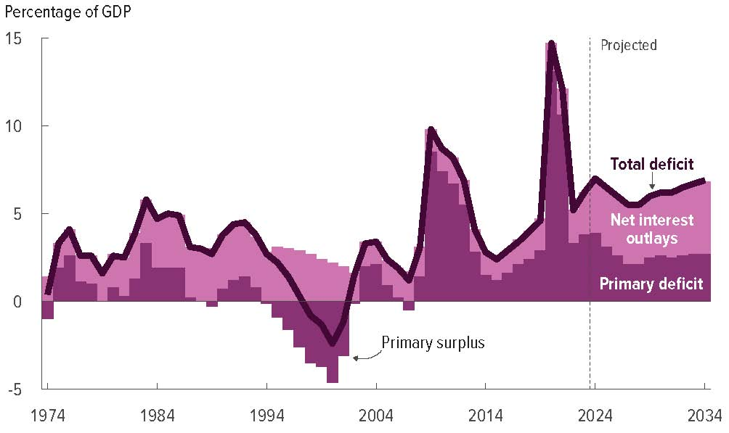
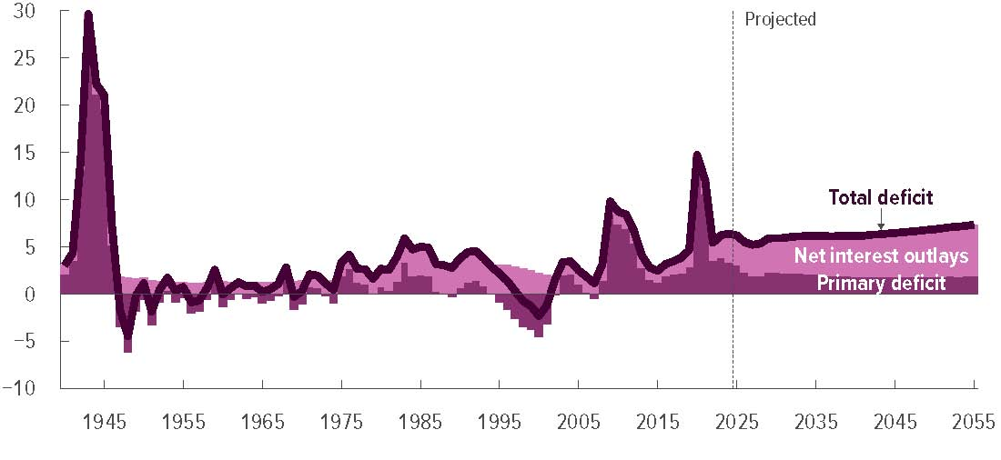
Rising Future Deficits
Source: CBO, The Long-Term Budget Outlook: 2025-2055

Slide 32
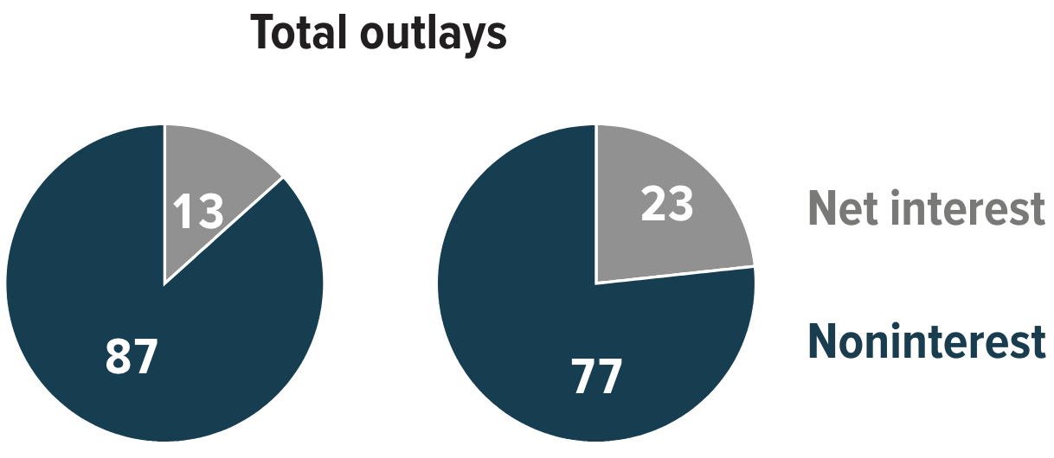
Interest Will Grow as a Share of Spending
Primary
Interest
2024 2054
Source: CBO 2023 Long Term Budget Outlook

Slide 33
Why is it so Hard to Reduce the Deficit?
Expenditures Growing:
  Healthcare spending
  Economic stimulus
    E.g., during the Great Recession & COVID
  Military engagements overseas
  Social Security
Revenues Falling:
  Tax cuts
  Slower labor force growth

Slide 34
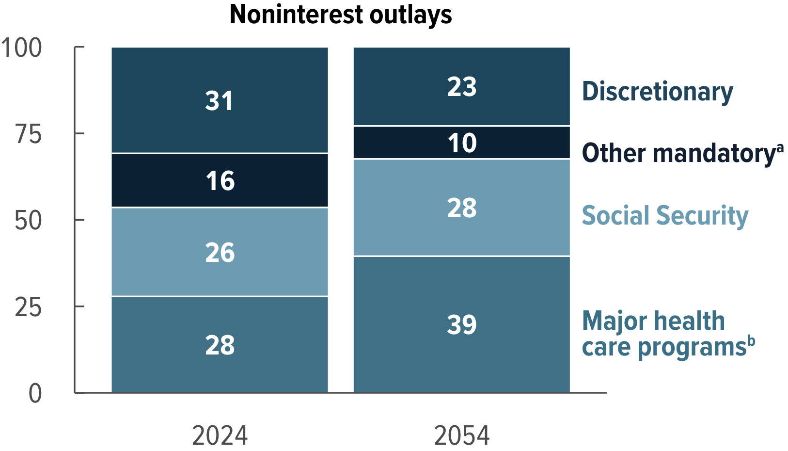
The Primary Drivers Going Forward
Social Security
And Medicare
Source: CBO 2024 Long Term Budget Outlook

Slide 35
Some Healthcare Spending Facts
The U.S. spent about $5.7 Trillion on healthcare in 2025
  About 18% of GDP (down from 19.5% in 2020)
The Federal Government (mostly via Medicare and Medicaid) was responsible for 33% of this spending
Note: Spending = Price * Quantity

Slide 36
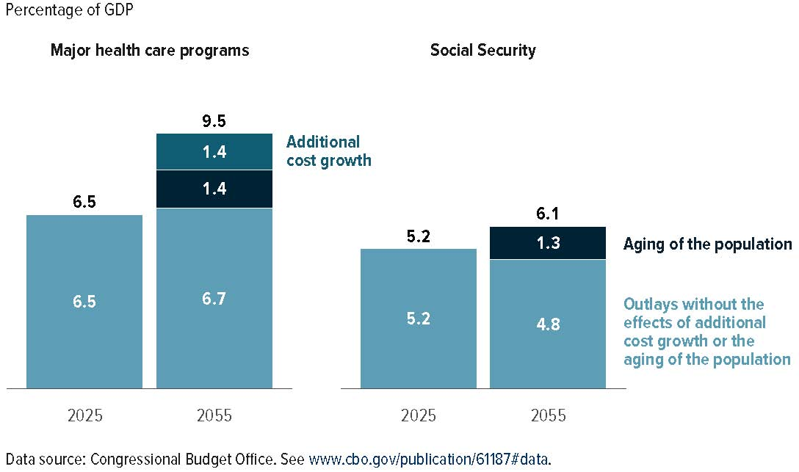
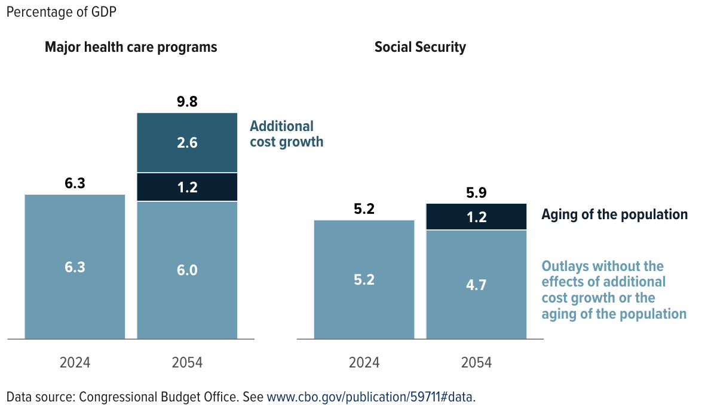
Healthcare is the bigger problem

Slide 37
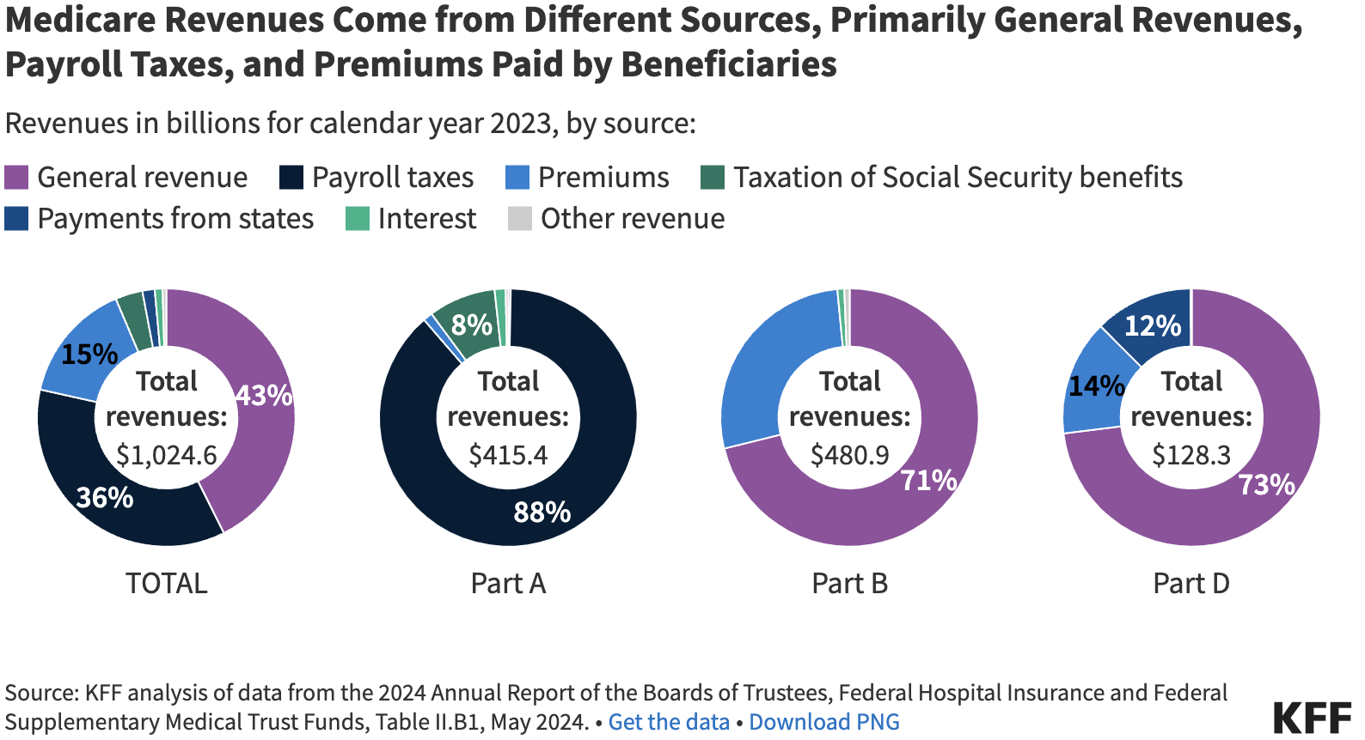

Slide 38
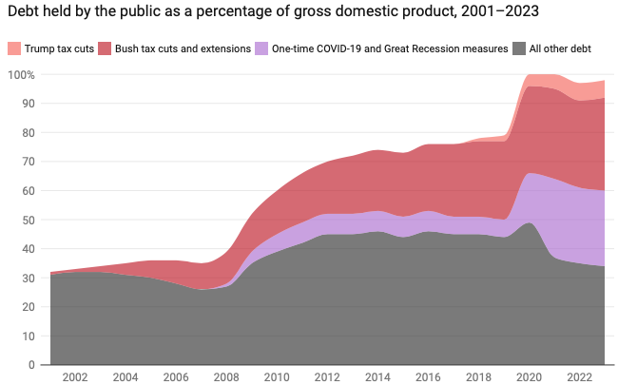
Tax Cuts Have Contributed to Debt Increases
Trump Tax Cuts: 6% of GDP
Bush Tax Cuts: 32% of GDP
Great Recession & COVID: 26% of GDP
The rest: 34% of GDP
Up from 31% in 2001

Slide 39
Thinking about other spending….
Do we have a spending problem?
Are there any programs people think should be cut?

Slide 40
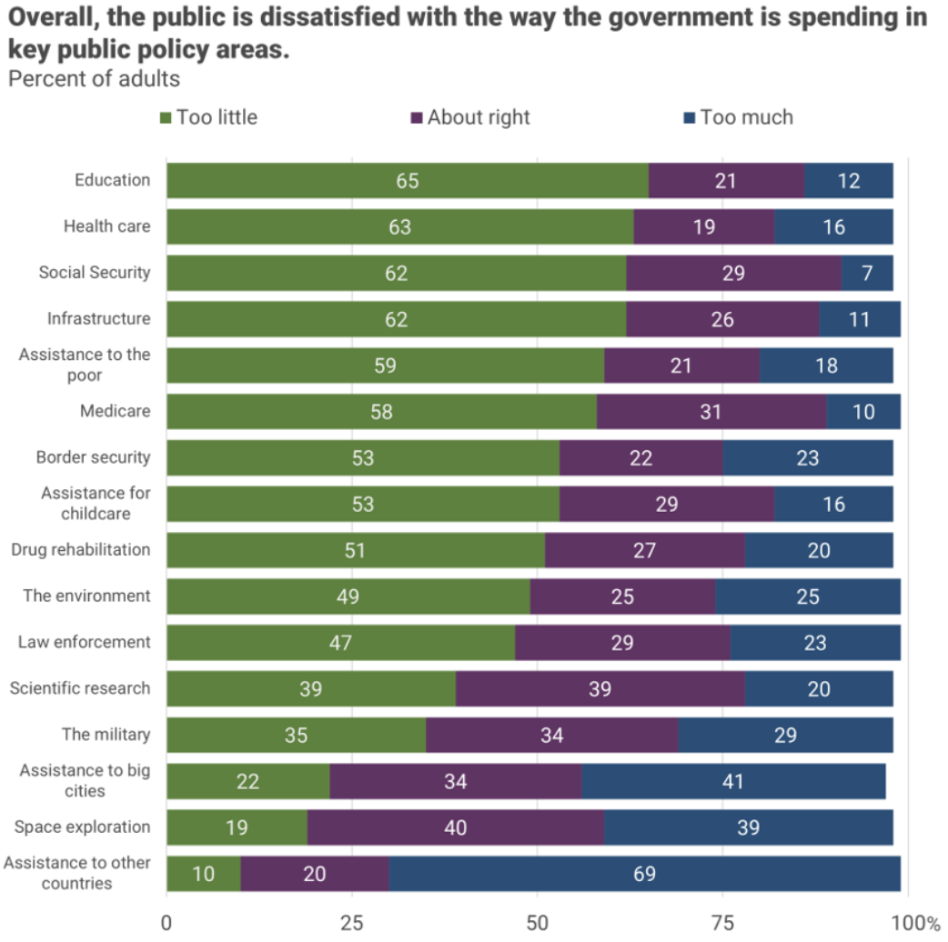
There is very little
enthusiasm for
cutting anything.
Source, NYTimes, Paul Krugman, “Why We Should, but Won’t, Reduce the Budget Deficit”
Notes:
From Krugman’s NYT column, October 10-11, 2023

Slide 41
Thinking about other spending….
General opinion is that we don’t spend enough on many programs ➔ Not much public support for deficits being a problem of too much spending.
Of course, no one wants to pay more in taxes either.
Note: economics doesn’t say anything about the right amount of spending or taxes – only that they should both be about the same amount

Slide 42
Three Major Questions:
What economic effects do deficits have?
Why is it so hard to reduce the deficit?
What could happen if our debt continues to increase?

Slide 43
Traditional View: Debt not a serious problem
Unlike households, the government does not have to repay its debt
    Retirees cash in maturing bonds, which are financed with new bonds sold to younger people.
    Interest on the debt is essentially paid by the young to their parents.
      When the young are old, their young will do the same for them.

Slide 44
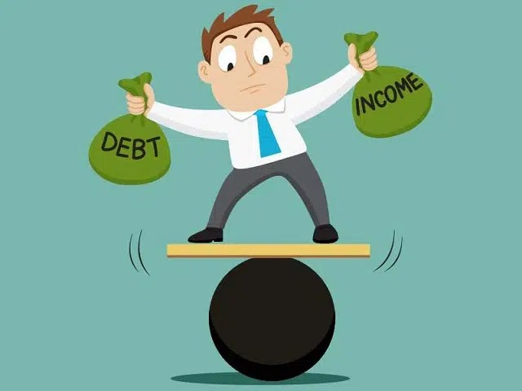
So, Why Worry About It?
If debt continues to grow…
  Interest payments will grow with it.
    14% of spending in 2026.
    25% of spending in 2056 (projected)
Rising interest rates:
  average interest rate was 1.9% from 2014 to 2023. The Congressional Budget Office (CBO) projects the average interest rate on public debt will grow from 3.4% in 2026 to 4.2% in 2047
Rising debt reduces budgetary options
30% of interest payments go to people in other countries

Slide 45
So, Why Worry About it?
If debt becomes too high…
  Investors might start questioning the creditworthiness of the US government and refuse to continue to lend to it.
    Problem: Nobody knows how high is too high.

Slide 46
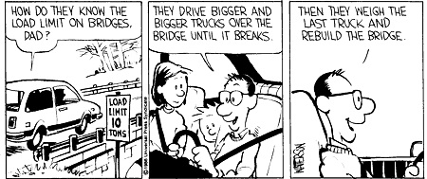
How much is too much?
Trucks = Debt; Bridge = Our Economy
Apologies to Bill Watterson!

Slide 47
So, Why Worry About it?
If debt becomes too high…
  It becomes more difficult to borrow in times of need.
    E.g., War, severe recession, pandemic, etc.
    Certainly, we have less flexibility now than 15 or 20 years ago.
  Could start to crowd out investment by consumers and businesses.
    Not currently a problem, but no idea if/when it could become one.
  Could be inflationary (unlikely)
  Could give political power to foreign governments (highly unlikely!)

Slide 48
How Does the US Government Borrow?
Treasury Department frequently auctions off IOUs
  Over $1 trillion every month!!
  Including Treasury bills, notes, and bonds; Treasury inflation-protected securities (TIPS); Savings bonds (non-tradable)
  Most of the money is used to pay off maturing bonds
Who buys the debt?
  Other federal agencies, Individuals and businesses (especially banks), State and local governments, Foreign government and individuals
A problem would arise if there were not enough buyers (i.e., lenders) because the government could not repay the maturing bonds
  Currently many more buyers than bonds sold; this helps keep interest rates paid on the debt low

Slide 49
What Is a Fiscal Crisis?
Caused by: Greatly increased perception of riskiness of government debt leading people to stop buying government bonds.
  Government would be unable to repay its maturing debt
Potential manifestations:
  Sudden and significant increase in interest rates
  Plunging exchange rates
Potential results:
  Dramatic budget reforms may be necessary to stave off actual default.
  Severe recession from dramatic declines in government spending and (because of higher interest rates) investment and consumption
  Higher interest bill on existing debt

Slide 50
CBO on the Possibility of a Fiscal Crisis
The United States currently benefits from the dollar’s position as the world’s reserve currency and
The federal government borrows in dollars,
Therefore, a financial crisis—similar to those that befell Argentina, Greece, or Ireland—is much less likely in the United States.
Although no one can predict whether or when a fiscal crisis might occur or how it would unfold, the risk is almost certainly increased by high and rising debt.
Crises of confidence, in addition to being unpredictable, happen very quickly. (Credit rating agencies have downgraded US debt in the past, citing concerns about ability and willingness to repay it.)
Source: CBO – Federal Debt: A Primer, March 2020

Slide 51
The Key: Stabilization of Relative Debt
Stabilization of relative debt might forestall the consequences of chronic deficits.
Problem: The US relative debt level is in no way stable!
Budget surpluses are not necessary, but budget control is.

Slide 52
Stabilizing the Relative Debt
Remember:
  the denominator of relative debt is GDP
  the numerator is debt
The denominator grows at the rate of growth of GDP.
The numerator grows with:
  the interest rate on the debt plus (or minus)
  the effect of the primary deficit (surplus)
Notes:
  relative debt can fall, even with a deficit, if it causes the debt to grow more slowly than GDP.
  Relative debt could rise with a surplus if interest rates are high enough.

Slide 53
OK: Relative Debt Cannot Grow Forever, But
Does it matter at what level we stabilize relative debt?
Relative debt stops growing:
  when the growth of debt is less the growth in GDP (on average).
The bigger the relative debt, the smaller the effect of a primary surplus or deficit.

Slide 54
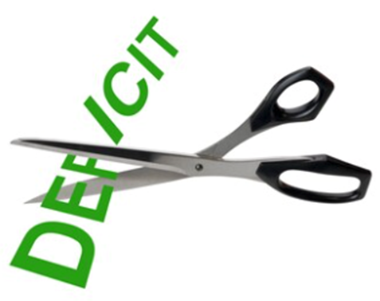
Other Thoughts on Government Debt
In time, interest payments will crowd out other government spending
Many economists think it is reasonable to borrow at low interest rates for investment
  For example, for infrastructure
A large debt encourages government bias toward higher inflation
  Inflation reduces real value of current debt (but not new debt)
Eventually will have to dramatically reform the budget, significantly cutting many programs, including most social programs

Slide 55
How To Address the Debt?
The question isn’t taxes vs spending cuts.
The question is:
  Who should bear the burden of solving the problem?
    Spending cuts will primarily burden lower-income households.
    Tax increases will primarily burden high-income households.
    Soc Sec benefit cuts (age limit, actual payments, etc.) will primarily burden current retirees and lower-income households.
    Doing nothing will increase the cost and push the burden out to younger people/households

Slide 56
There Are Other (Bad/Costly) Solutions
Financial repression
  Using regulation to force down interest rates.
Paying the interest by printing money.
  Risks inflation, hyper- or otherwise.
Encourage inflation in other ways
  Reduces the real value of current debt (but not new debt)
Or defaulting on the debt.
  This will forever raise the cost of government borrowing.

Slide 57
Bottom Line: We Need to Worry about the Debt
Interest rates were low for many years, no more!
A fiscal crisis should be avoided at all costs.
Stabilizing relative debt would substantially reduce the possibility of a crisis.
The good news is we can stabilize relative debt without a primary surplus.
Question is not WHETHER the US will have to act…
but WHEN.

Slide 58
Takeways
Some combination of spending cuts and tax increases should be enacted to stabilize relative deficits
The particular combination of spending cuts and revenue increases is a political question
The longer we wait to address the deficit, the harder and more disruptive addressing it will be. Given the fiscal challenges of an aging population and climate change, it is better to do this sooner than later.
But high debt levels should not deter:
  Productive infrastructure investment.
  Fiscal responses to crises.

Slide 59
What is the Debt Ceiling?
An amount of debt that the federal government can not exceed without congressional approval.
From the Constitution: only Congress can authorize the borrowing of money on credit of the United States (Article I, Section 8).
During WWI, requests came so fast and furious, that Congress put in place the Debt Ceiling.
  Approvals then occurred only periodically.
And it continues today.

Slide 60
5 Things to Know about the Debt Ceiling
The debt limit has been raised continually for more than a century.
Raising the debt limit is not about new spending; it is about paying for previous choices policymakers legislated.
Only one other advanced country—Denmark—has a separate debt limit rule like ours (but theirs isn’t binding).
The economic consequences of a large-scale, intentional default are unknown, but predictions range from bad to catastrophic.
Souce: https://www.brookings.edu/2023/01/19/7-things-to-know-about-the-debt-limit/

Slide 61
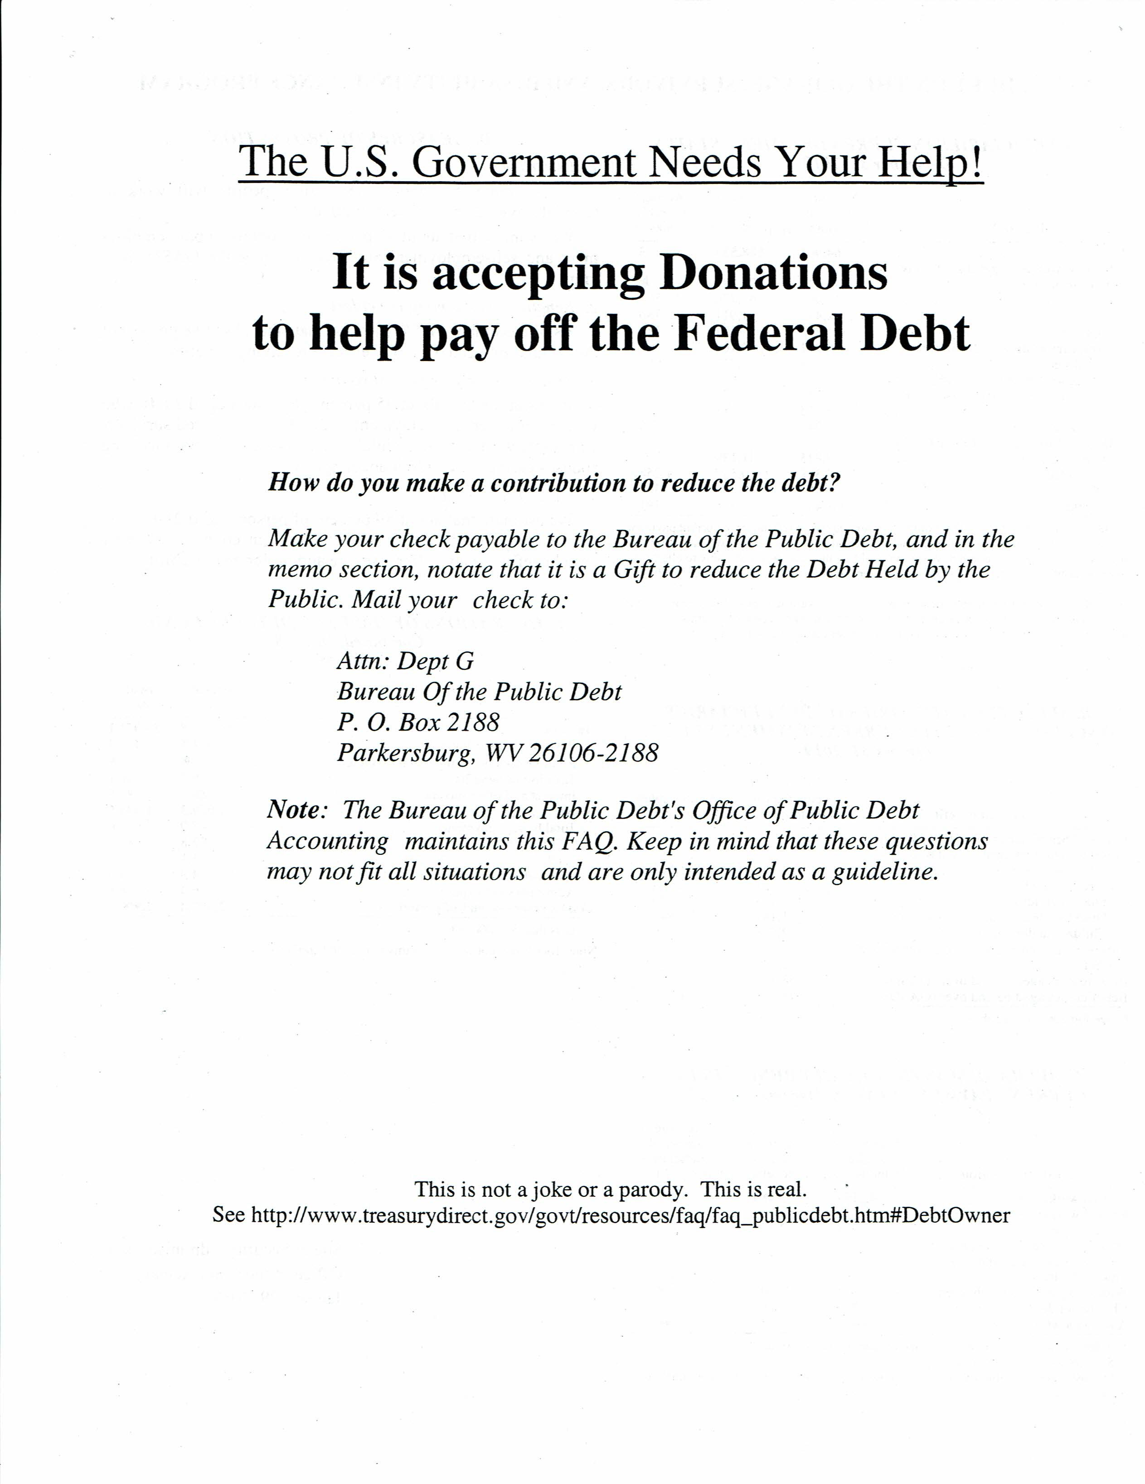

Slide 62
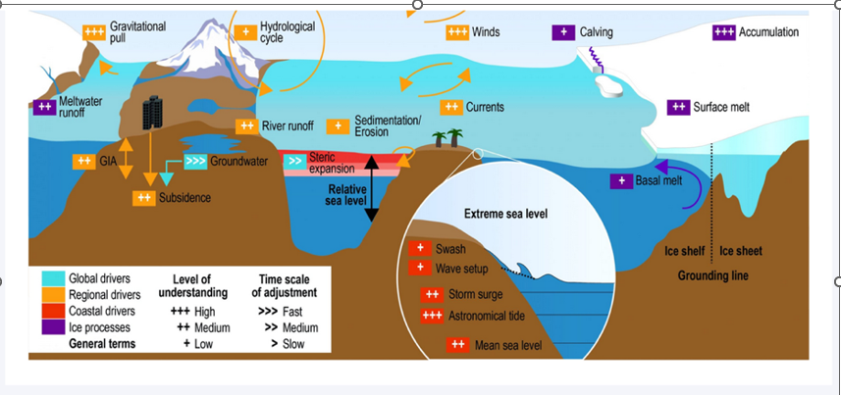
The Drivers of regional Sea Level Rise

Slide 63
Thank you!
Any Questions?
www.NEEDEcon.org
Robert Rebelein
Rebelein@vassar.edu
Contact NEED: info@NEEDEcon.org
Submit a testimonial: www.NEEDEcon.org/testimonials.php
Become a Friend of NEED: www.NEEDEcon.org/friend.php

